Slide 1
Smart payment card
Integration Project

Slide 2
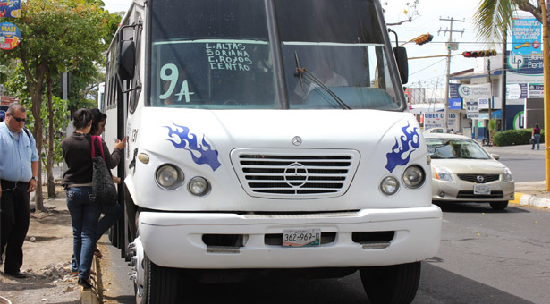
Problem approach
The public transport service by bus is a widely used way to get transport; actually students and elderly people have an special discount.
Until now the payment method is with cash and takes place between the customer and the driver of the unit.
This system is slow and inefficient despite that there are alternative payment ways such as tickets to the people of the groups already mentioned.
Therefore, transport companies need an application that helps them to manage the user fees.

Slide 3

requirements
According to the stated problem is deduced that the needs are:
Develop a database to store certain personal data.
It have to classify users into 4 main types: students, elderly people, disabled persons and the general public.
Each user has their own fee.
It have to generate reports by date ranges: statistical, frequency of use, etc.

Slide 4
Analisys of feasibilities
For the realization of this project there will not be the need much budget, since it is only a simulation and it won't be fully implemented.
The benefits would be the improve of fare collection control, higher profits, shorter payment time etc.

Slide 5
realization
For the realization of our project we used the C # programming language and the database was created with ACCES, we chose these two because it is what we are currently learning.
In addition to the topics learned with programming teacher.

Slide 6
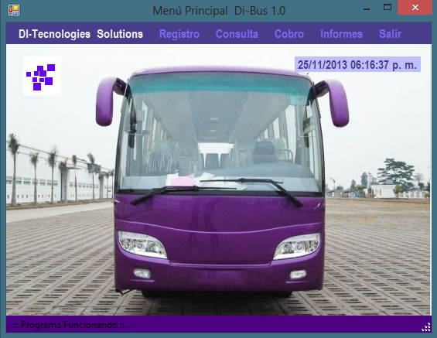
Main screens
This is our main menu screen, and through it we will have access
to other options, among them, our program have :
Register, renew, delete users.
Collect or make these refills.
Consults about the buses and the users.
Reports balances and profits.

Slide 7
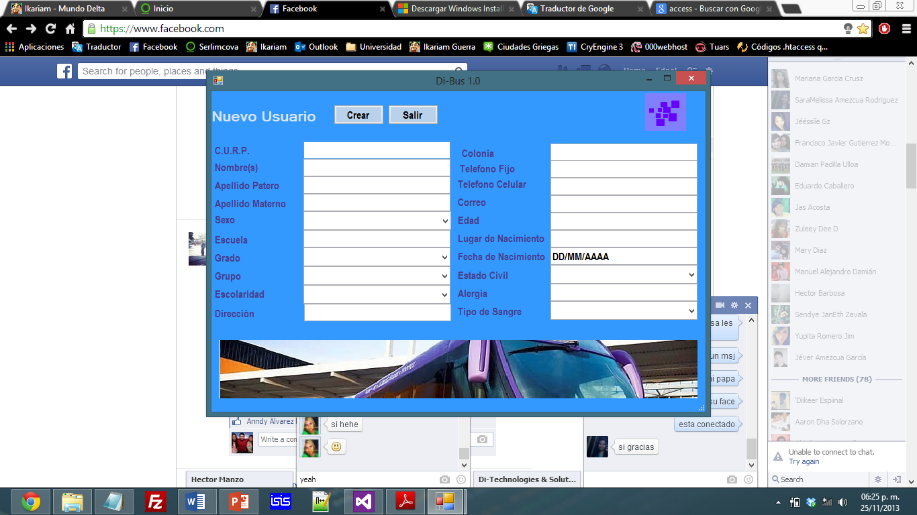

Slide 8
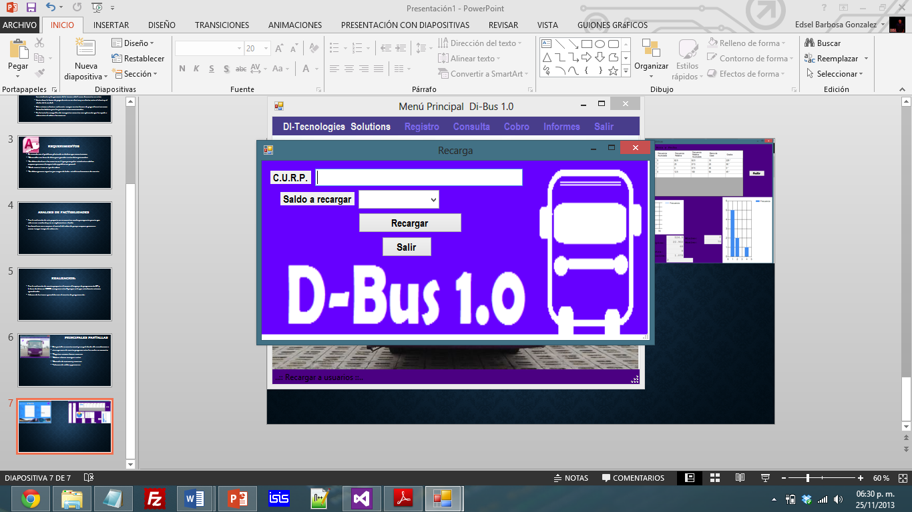

Slide 9
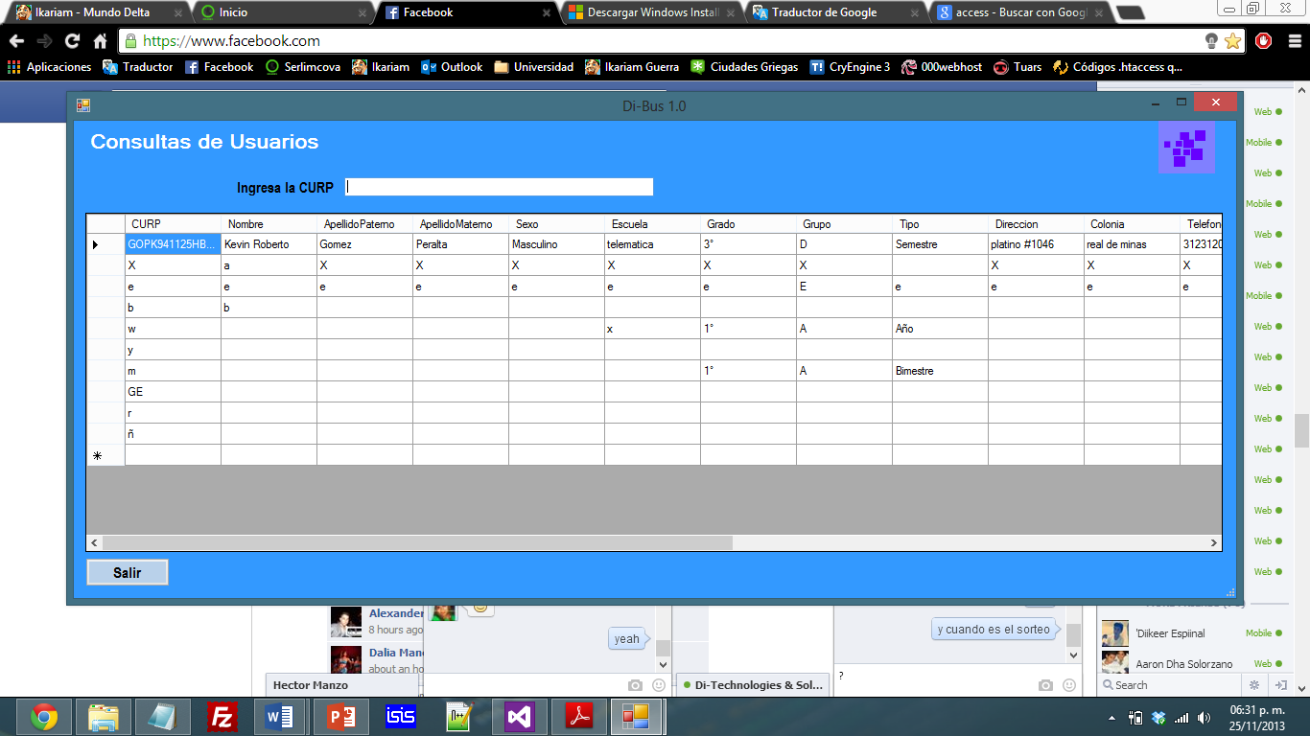

Slide 10
